Slide 1
Power aerobic
Evaluation of aerobic power in different sports disciplines by field method
Mohammad tajik
p.h.d exercise physiology
Summer 1401

Slide 2
Cooper
General test
VO₂ = 3.126 (meters in 12 min) - 11.3

Slide 4
1.5 mile run
General test
VO₂ = 3.5 +( 483/time in minutes to run 1.5 miles)
Rockport Walking Test (1 mile walk)
VO₂ = 132.853 - 0.1692 (BW in kg) - 0.3877 (age in y) + 6.315 (gender) - 3.2649 (time in min) - 0.1565 (HR)
0 for female; 1 for male; HR at end of walk

Slide 5
20 meter shuttle rum test
General test
vo2max(ml/kg/min)=0.38*total number of shuttles completed+25.98

Slide 9
Yo-Yo tests
The Yo-Yo intermittent endurance test (YYIET)
The Yo-Yo intermittent recovery test (YYIRT)
VO₂ max = distance in meters x 0.0136 + 45.3

Slide 10
Why special tests?

Slide 11
Why special tests?
It does not cost much
Applicability
Specific to sports
Predict future performance
Shows weaknesses
· Evaluating the success rate of educational programs

Slide 12
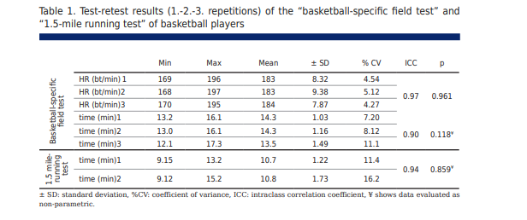
Basketball specific field test (BSFT)
basketball

Slide 13
Basketball specific field test (BSFT)
basketball

Slide 14
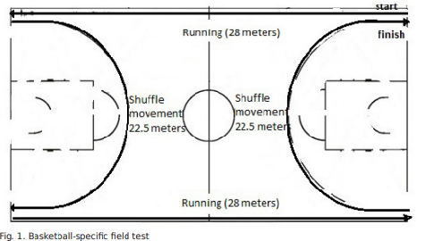
Basketball specific field test (BSFT)
basketball
VO2max level: 122.617–5.461×(BSFT duration)

Slide 15
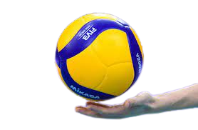
volleyball-specific cardiorespiratory function measurement
volleyball

Slide 16
volleyball-specific cardiorespiratory function measurement
volleyball

Slide 17
Handball specific complex test (HBCT)
handball

Slide 19
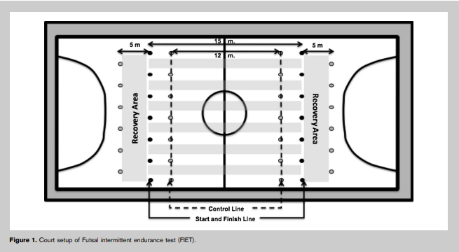
Futsal intermittent endurance test ( FIET)
futsal

Slide 20
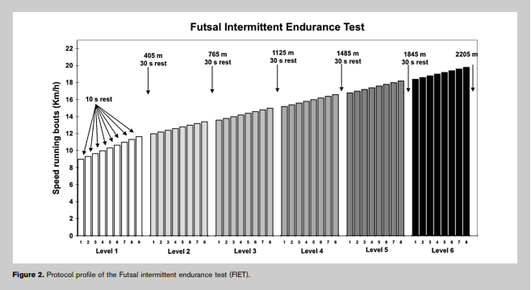
Futsal intermittent endurance test ( FITE)
futsal

Slide 21
Futsal

Slide 22
Hoff test
football

Slide 23
Hoff-Helgerud test meter | Maximal Oxygen Uptake mL·kg-1·min-1
1300 | 48
1320 | 49
1340 | 50
1360 | 51
1380 | 52
1400 | 53
1420 | 54
1440 | 55
1460 | 56
1480 | 57
1500 | 58
1520 | 59
1540 | 60
1560 | 61
1580 | 62
Hoff-Helgerud test meter | Maximal Oxygen Uptake mL·kg-1·min-1
1600 | 63
1620 | 64
1640 | 65
1660 | 66
1680 | 67
1700 | 68
1720 | 69
1740 | 70
1760 | 71
1780 | 72
1800 | 73
1820 | 74
1840 | 75
1860 | 76
1880 | 77
1900 | 78

Slide 24
Bangsbo-test
football

Slide 25
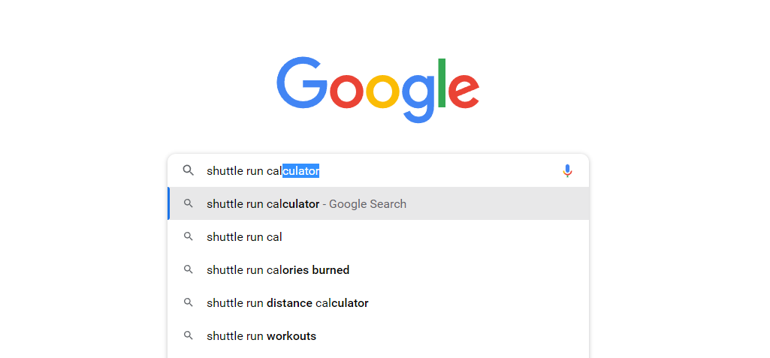

Slide 26
Good luck

